Slide 1


What in the
Federal Title is this?
WAPL Annual Meeting
June 2020
Tatyana Bannan
Licensed in WY and CO
Hampton & Milligan PLLC

Slide 2
ROADMAP
BLM Lands and Federal Leasing Overview
Federal Lease Terminology
Federal Lease Conveyance Examples
Federal vs. Fee Confusion
Records
Two Chains
GLO Records
LR2000
WOGCC
COVID-19 Updates and Discussion
Federal Lease Extension Options
Federal Lease Reinstatements
BLM COVID-19 Relief
Leases Status on LR2000 and other new features
Unemployment & Resources
AAPL CEUs and Certifications
Questions and Links

Slide 3
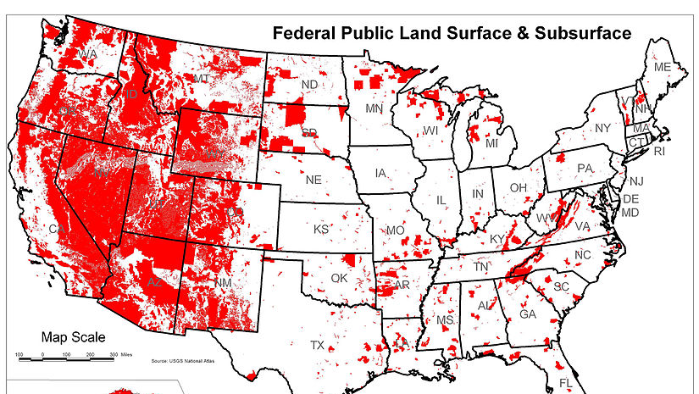
Notes:
Why Federal Title is relevant

Slide 4
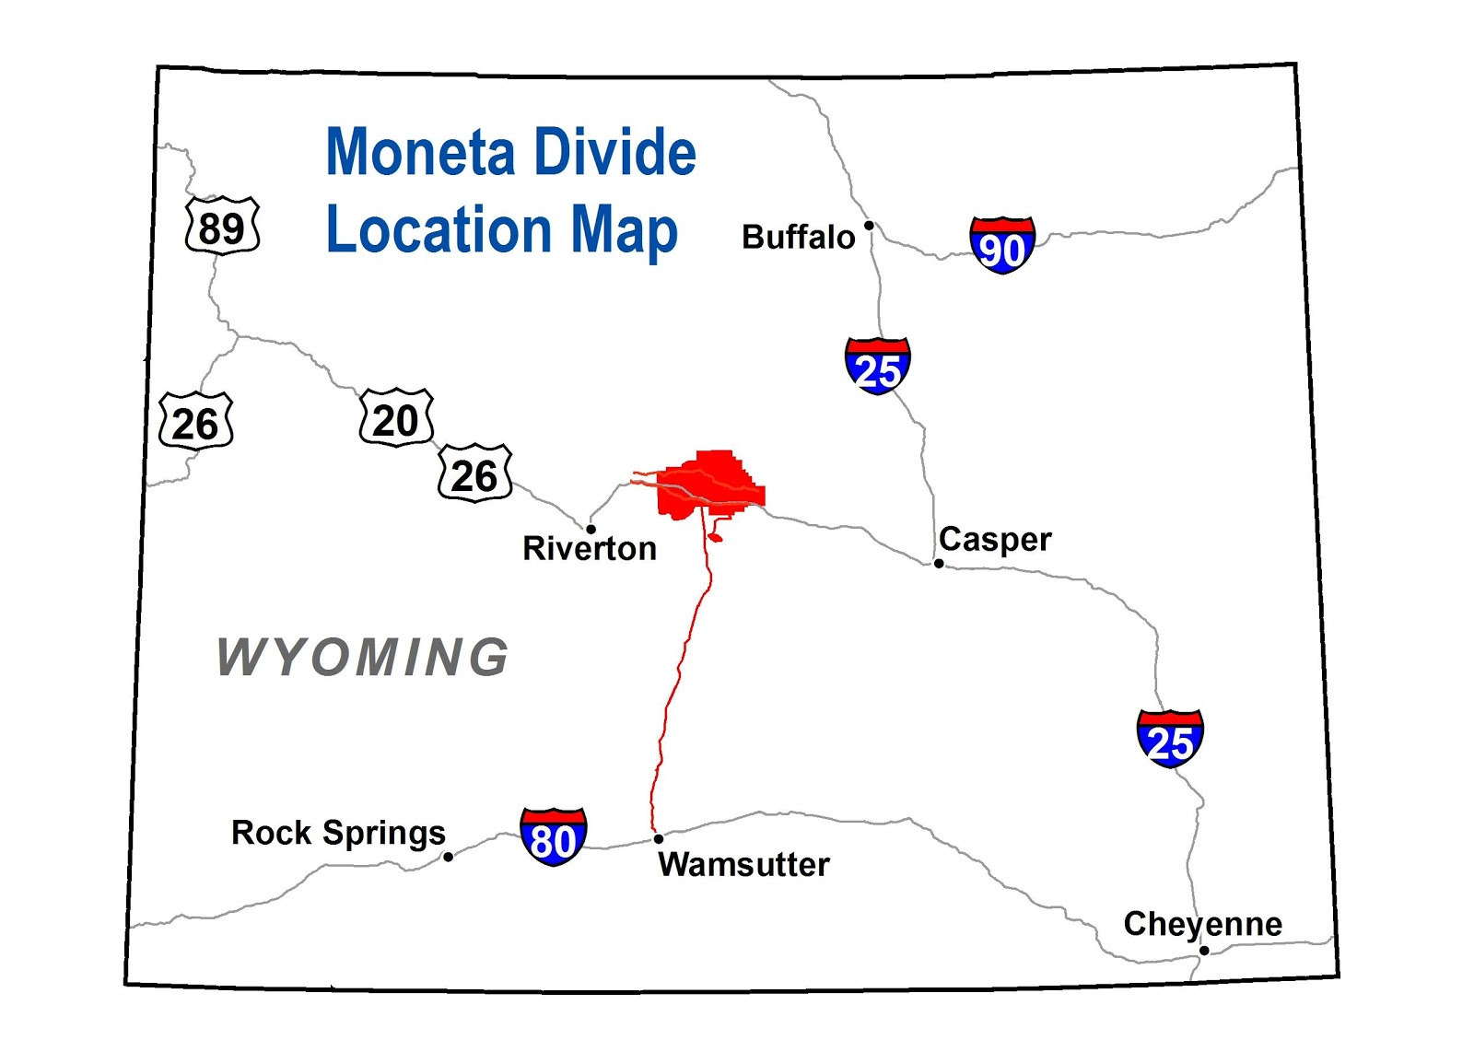
BLM Lands and Leasing
Resource Management Plan (RMP)
  NEPA and EIS
  Parcels nominated for leasing
  Moneta Divide and
  Wyoming Pipeline Corridor Initiative
Online Lease Sales
  Competitive vs. Noncompetitive
  Quarterly
Lease Terms and Stipulations
  10 years
  Surface, Sage Grouse, Timing, etc.

Slide 5
Federal Lease Terminology
Initial Lessee
  Record Title
    obligation to pay rent, and the rights to assign and relinquish the lease -43 CFR § 3100.0-5(c)
  Operating Rights
    authorizing the holder of that right to enter upon the leased lands to conduct drilling and related operations, including production of oil or gas from such lands in accordance with the terms of the lease -43 CFR § 3100.0-5(d)
  Unsevered and Joint
Transfer/Assign
  If unsevered – assigns both record title and operating rights
  If severed
    Assignment of record title
    Transfer of operating rights

Slide 6
Federal Lease
Record Title vs. Operating Rights
Record Title
  A lessee's interest in a lease which includes the obligation to pay rent, and the rights to assign and relinquish the lease.
  Original lessee at time of being granted a Lease will hold unsevered record title (meaning operating rights are fully owned also).
  Operating rights are severable from record title interests.
  Can be assigned vertically which will cause lease segregation. Cannot be assigned horizontally.
Operating Rights (working interest)
  Interest created out of record title authorizing the holder of that right to enter upon the leased lands to conduct drilling and related operations, including production of oil or gas from such lands in accordance with the terms of the lease.
  Can be transferred horizontally and vertically. Overriding royalty interests are assigned from operating rights interest.

Slide 7
Ex. 1
BLM – WYW-123456
1-39N-74W
1
USA – 12.5% Royalty
A Oil Co. Original Lessee [Record Title and unsevered Operating Rights]
2
50% Operating Rights
B Oil Co.
3
2% ORRI to John Doe
A Oil Co. 100% Record Title and 50% Operating Rights – USA Royalty (12.5%*50%) = 43.75% Net Revenue
B Oil Co. 50% Operating Rights – USA Royalty(12.5%*50%) – ORRI (2%x50%) =42.75% Net Revenue
4
25% Record Title
C Oil Co.
A Oil Co. 75% Record Title and 50% Operating Rights – USA Royalty (12.5%*50%) = 43.75% Net Revenue
B Oil Co. 50% Operating Rights – USA Royalty(12.5%*50%) – ORRI (2%x50%) =42.75% Net Revenue
C Oil Co. 25% Record Title

Slide 8
Ex. 2
BLM – WYW-123456
1-39N-74W
1
USA – 12.5% Royalty
A Oil Co. Original Lessee [Record Title and unsevered Operating Rights]
2
50% Record Title
B Oil Co.
A Oil Co. 50% Record Title and 50% Operating Rights – USA Royalty (12.5%*50%) = 43.75% Net Revenue
B Oil Co. 50% Record Title and 50% Operating Rights – USA Royalty (12.5%*50%) = 43.75% Net Revenue
3
50% Operating Rights
C Oil Co.
4
2% ORRI to John Doe
A Oil Co. 50% Record Title and 50% Operating Rights – USA Royalty (12.5%*50%) = 43.75% Net Revenue
B Oil Co. 50% Record Title and 25% Operating Rights – USA Royalty(12.5%*25%) = 21.875% Net Revenue
C Oil Co. 25% Operating Rights – USA Royalty(12.5%*25%) – ORRI (2%x25%) = 21.375% Net Revenue

Slide 9
Ex. 3
BLM – WYW-123456
1-39N-74W
1
USA – 12.5% Royalty
A Oil Co. Original Lessee [Record Title and unsevered Operating Rights]
2
2% ORRI to John Doe
A Oil Co. 100% Record Title and 100% Operating Rights subject to USA Royalty and ORRI – in Lease WYW-123456
100% Record Title
W/2 of Section 1-39N-74W
B Oil Co.
Lease Segregated
USA – WYW-789789
W/2 of Section 1-39N-74W
3
A Oil Co. 100% Record Title and 100% Operating Rights subject to USA Royalty and ORRI – in Lease WYW-123456
now covering E/2 only
B Oil Co. 100% Record Title and 100% Operating Rights subject to USA Royalty and Original ORRI (in Lease WYW-123456) – in Lease WYW-789789 covering W/2

Slide 10
Federal vs. Fee Confusion
“Record Title”
  Creates a lot of confusion because this same term, “record title,” usually refers to the holder of title as it appears in the county records when discussing fee leases.
  They are not the same!
Financial Responsibility
  The working interest bears the costs of developing the prospect.
  Federal
    Operating Rights – bears the costs of developing the prospect.
    If record title and operating rights have been severed federal record title owner would not be liable and has no rights to develop the prospect.

Slide 11
Records
BLM
  Case Files – BLM Field Office
    a copy of the lease, rental receipts, lease status notices, any filed assignments, and other documents, such as those relating to communization agreements and communications.
  Every assignment of record title and transfer of operating rights must be filed with the BLM on prescribed forms for approval.
  Transfer of overrides, production payments and similar interests are also required to be filed with the BLM but are not approved by the BLM.
County Records
  All instruments conveying or transferring real property interests must be filed of record in the county in which the land is located.
    Constructive notice
  Most states do not recognize the BLM records as imparting constructive notice.
    Torgeson v. Connelly, 348 P.2d 63 (Wyo. 1959)
Results in two chains of documents that often do not match

Slide 12

Two Chains
The chains don’t match!
  Missed documents
  Federal forms vs. unrestricted county documents
  Varying terms
Reconcile
  Merge the chains and fill in the gaps
  Require cross filings
  Federal Requirements vs. Constructive Notice

Slide 13
Online Records
GLO Records
LR2000
WOGCC

Slide 14
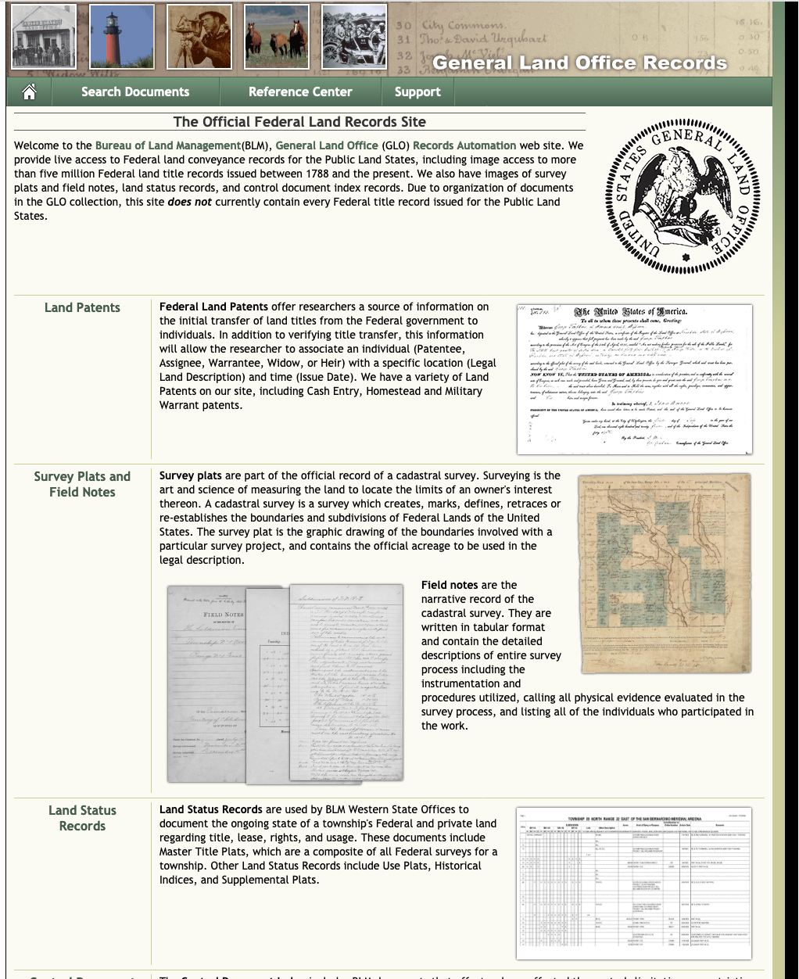
GLO Records
General Land Office
  Images of GLO records (federal land patents, survey plats and field notes, land status records, and tract books) issued between 1787 and present are publicly available on https://glorecords.blm.gov/
Patents
  The BLM maintains the original copies of patents, while copies in the county were often recorded or copied on patent forms.
  Verify and rely on the BLM records of original copies.

Slide 15
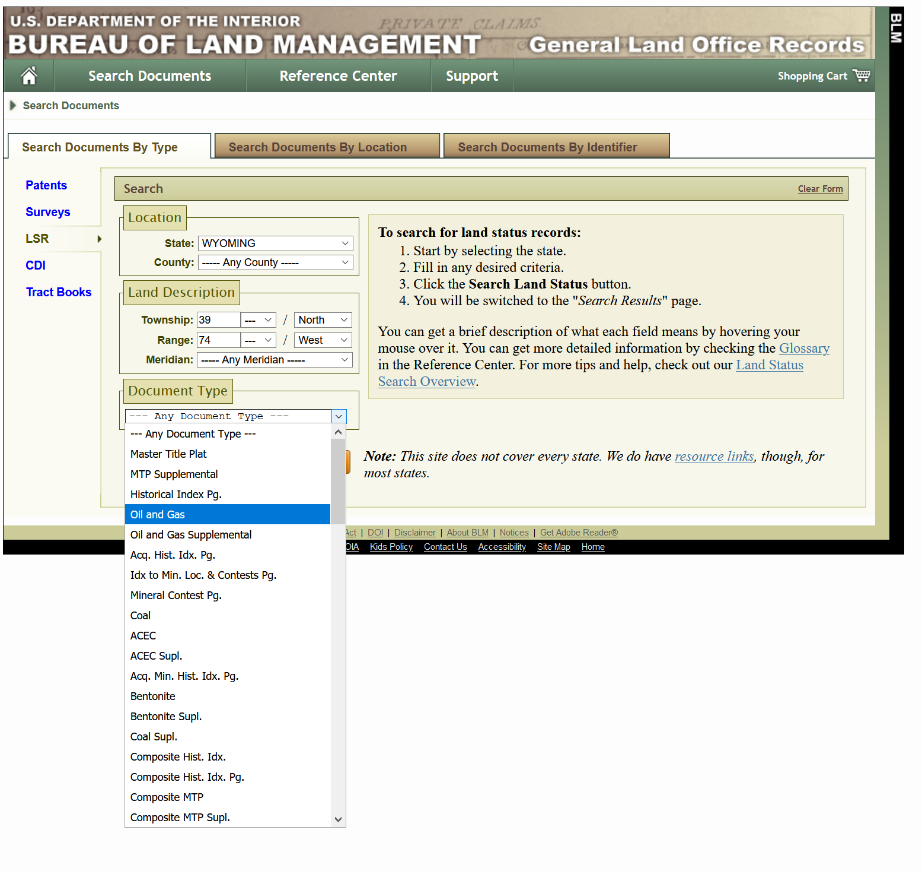
Land Status Record
The BLM maintains various land plats for each township
  Master Title Plat
  Oil and Gas Plat
  and many others
These plats indicate which lands are currently owned by the federal government, agency jurisdiction, and rights reserved to the federal government on private land, such as a mineral reservation in a patent. Additionally, plats are useful tools to determine what rights may exist on the lands, such as rights-of-way, fences, land management areas, and other uses, and should include all current federal oil and gas leases.

Slide 16
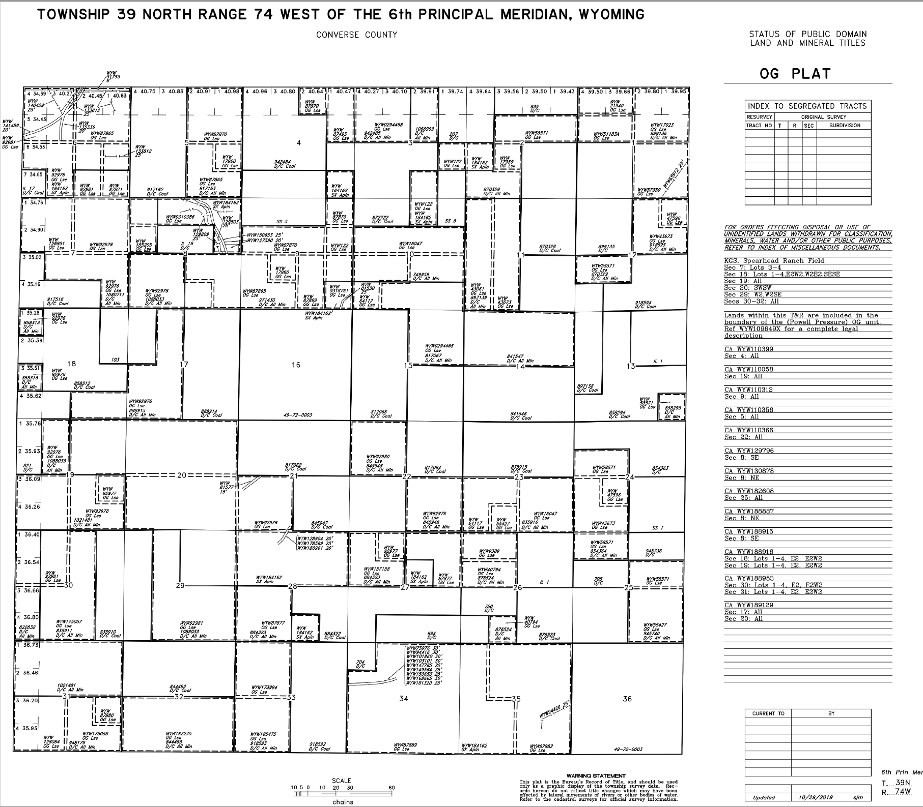
OG PLAT
Things to note:
Notations on the side of the plat
Updated date
Reference Center
  https://glorecords.blm.gov/reference/downloads/WY_Explanatory_Township.pdf

Slide 17
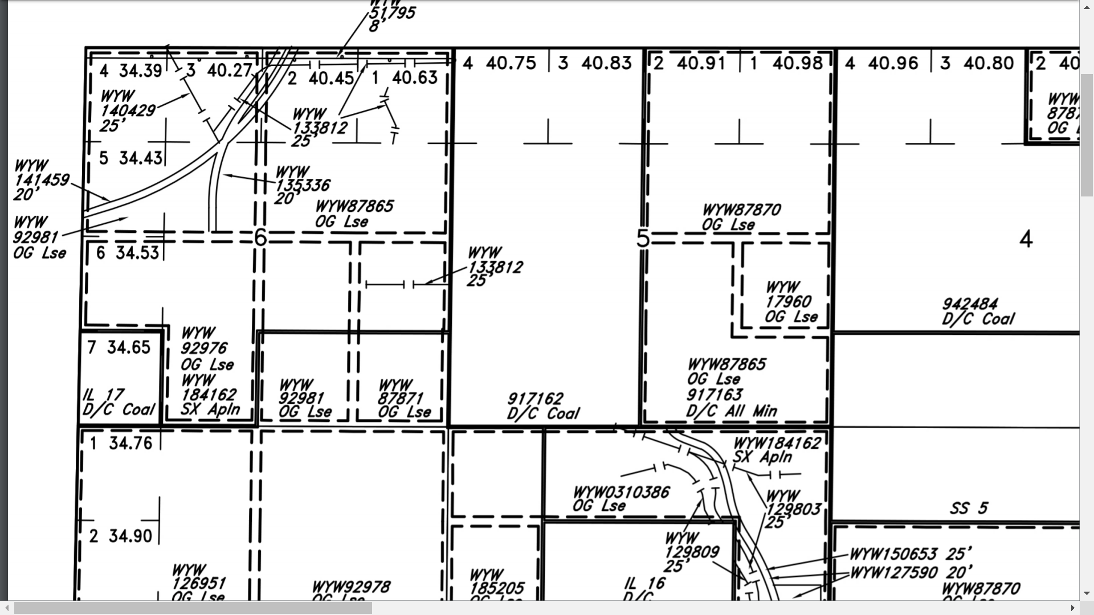
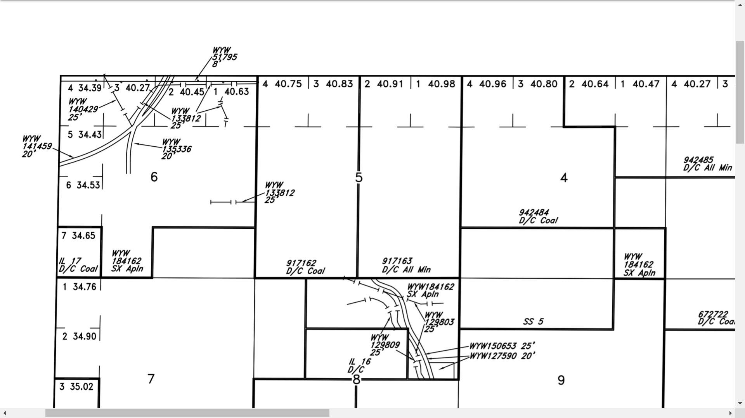
Master Title Plat Below
OG Plat Above

Slide 18

LR2000 Server Room
Circa LR2000 pre-update

Slide 19
LR2000
www.blm.gov/lr2000
LR2000 is a searchable database for reports on BLM authorizations
Geographic Index Report
  authorizations for a specific section of land
Serial Register Page
  snapshot of the BLM authorizations for one lease
  Lease status (active, expired, etc.), affected lands, acreage amounts, relevant dates (e.g., the effective date and expiration date), if production was achieved, communitizations, units, current record title owner and any operating rights owner recognized by the BLM and may contain entries relating to recent assignments that have not yet been included in the lease file.
The LR2000 does NOT include:
Deeds
Leases
Public Lands Orders
Case Files

Slide 20
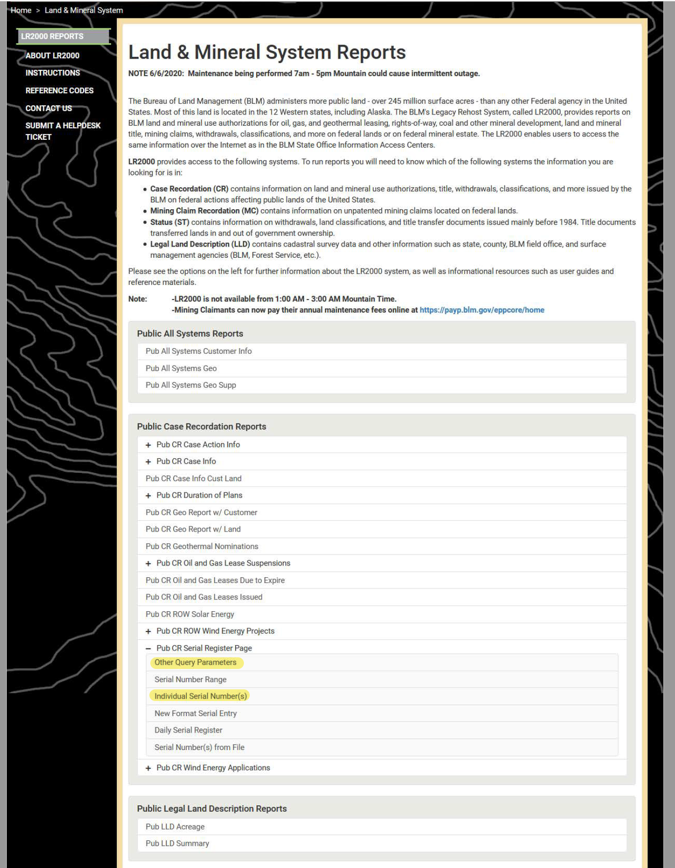
LR2000 Tutorial
Looking up Serial Register Pages (SRP) for Federal Leases in LR2000:
Individual Serial Number(s) – efficient if you know your exact Lease number.
Other Query Parameters – useful to look up all SRPs for the whole section, will show all current and expired oil, coal and other mineral leases, communitization agreements and unit agreements.

Slide 21
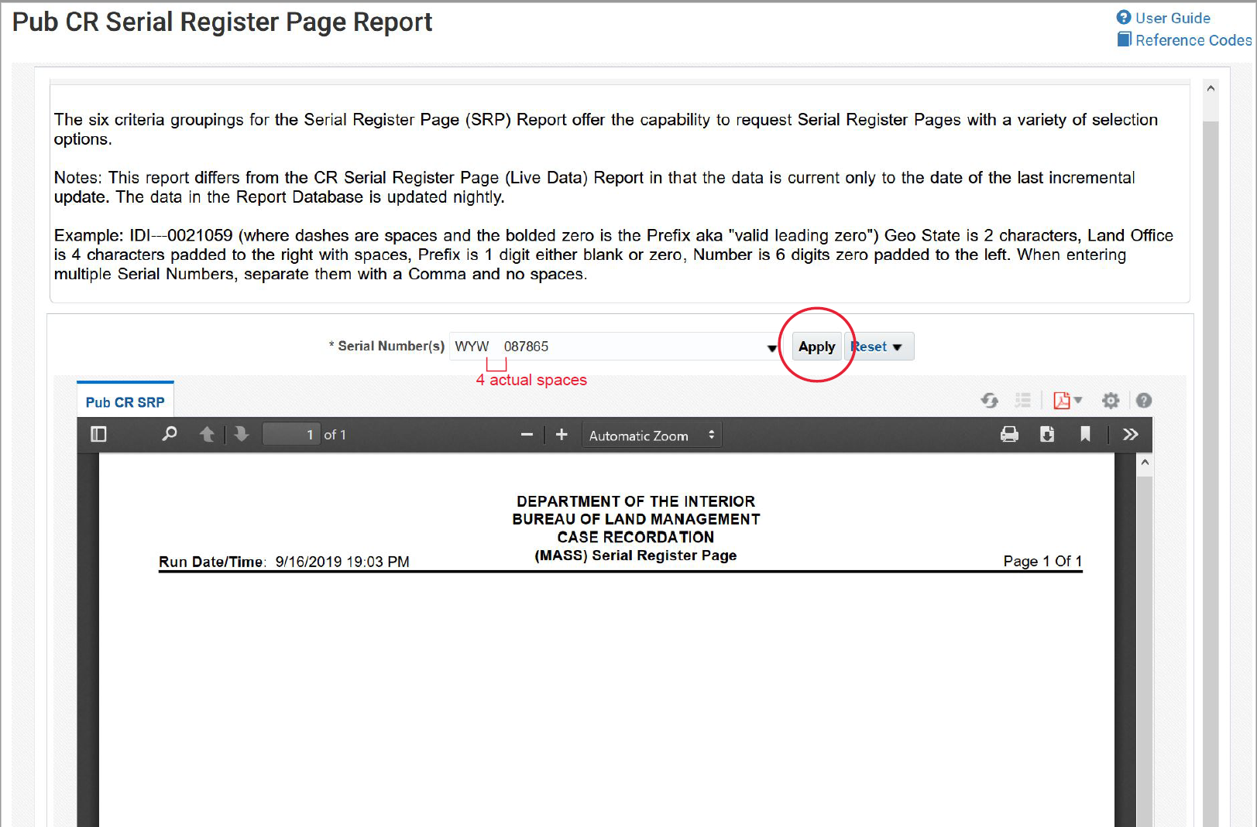
Individual SRP
Individual Serial Numbers:
Input your lease number into the window in the following format:
  WYW[4 physical spaces]123456
  If your lease is older and has a number shorter than 6 digits, add preceding zero(s). See example ->
You must physically press ‘Apply’ in order for the Lease SRP to pull up.
User Guide and Reference Codes in top right corner are very helpful.

Slide 22
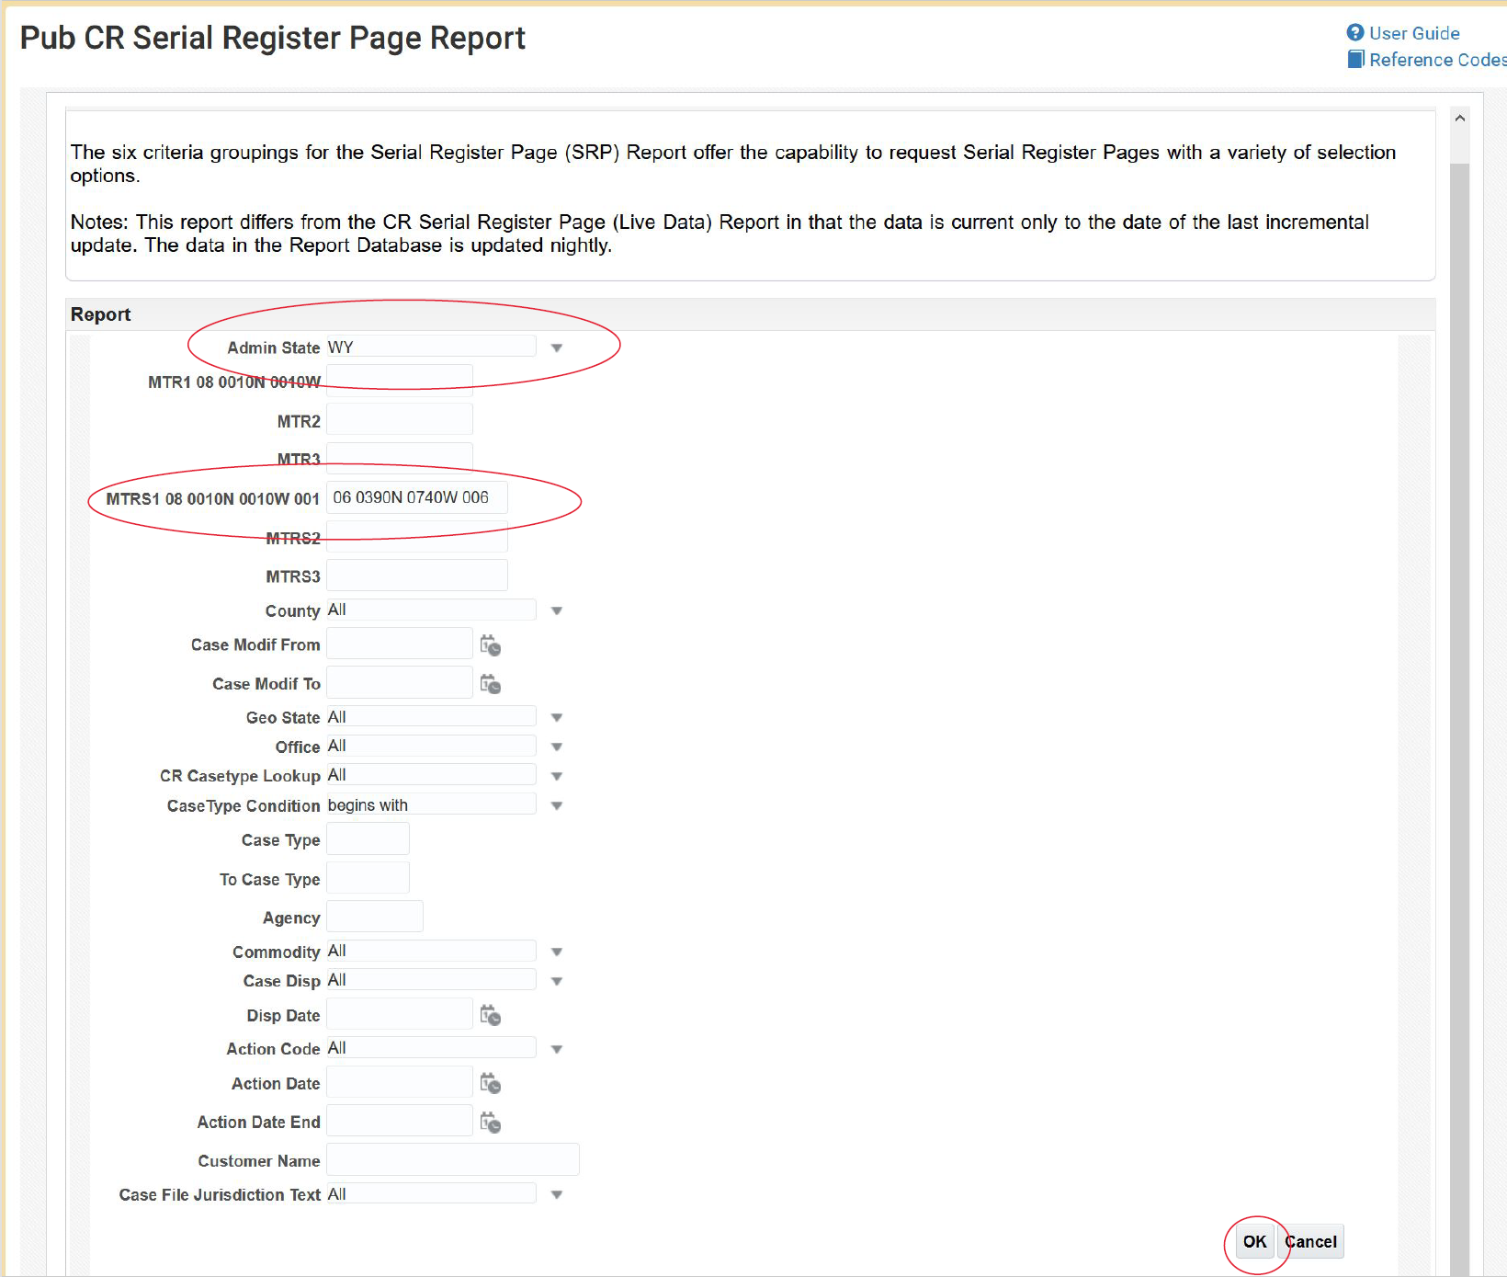
Full Section SRP
Other Query Parameters:
Select Admin State
Fill in the MTRS1 line as follows:
  2 digits for Meridian, space, 5 digits for Township, space, 5 digits for Range, space, 3 digits for section
  For example, Section 6-T39N-R74W would be in 6th Prime Meridian and entered as shown in the example ->
Press ‘OK’ to populate

Slide 23
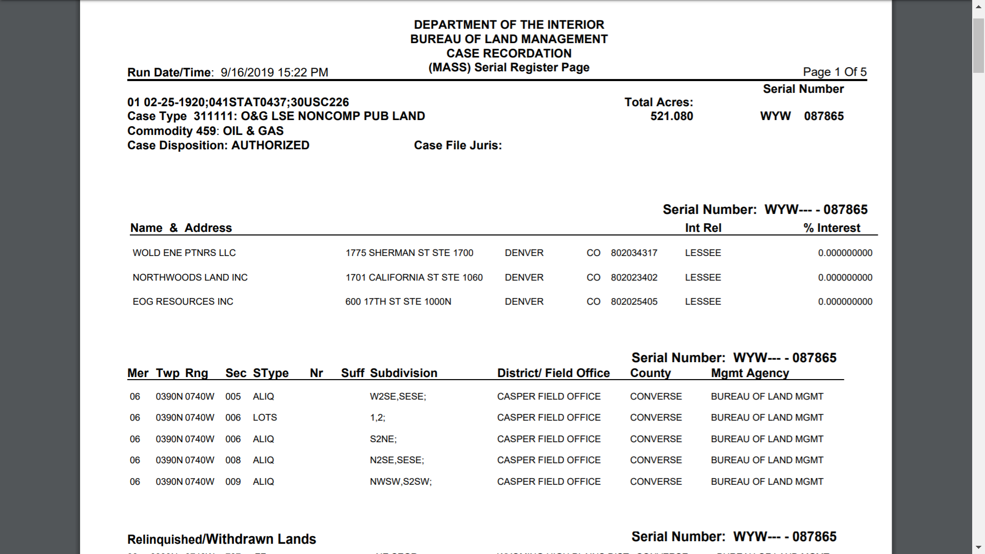

Slide 24
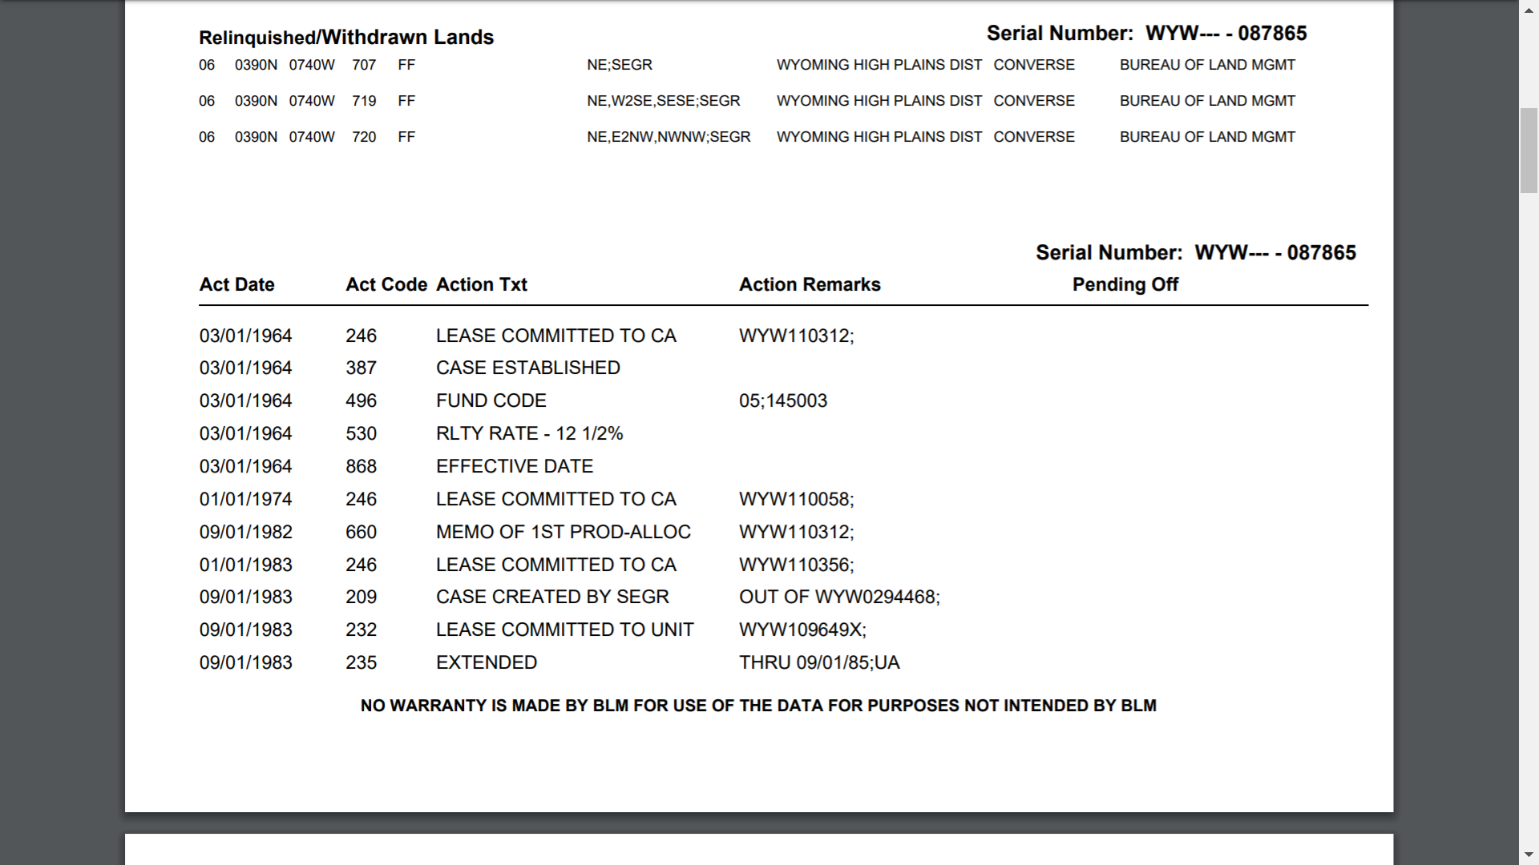

Slide 25
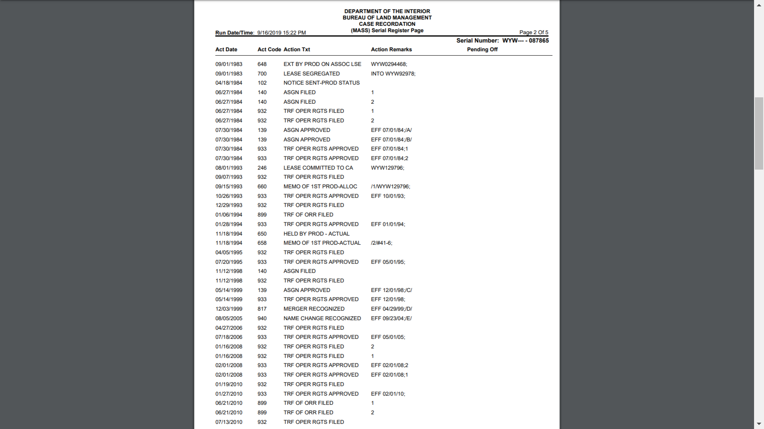

Slide 26
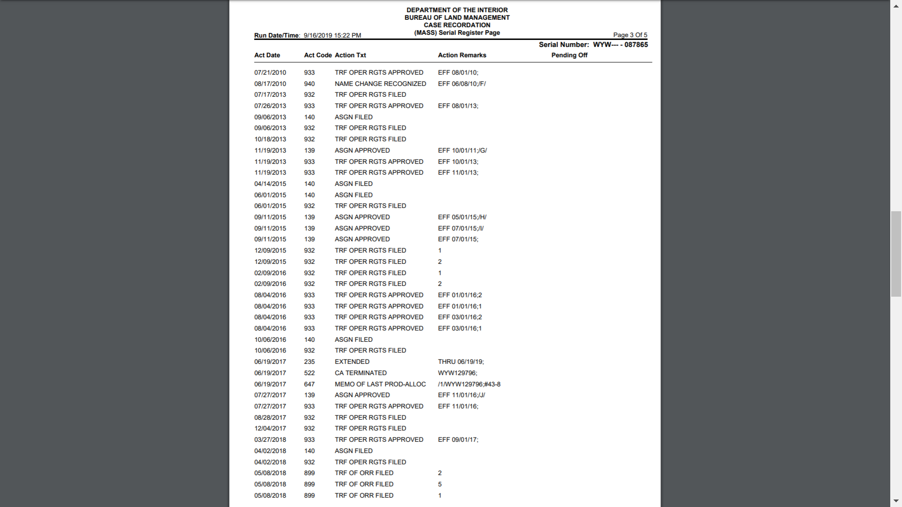

Slide 27
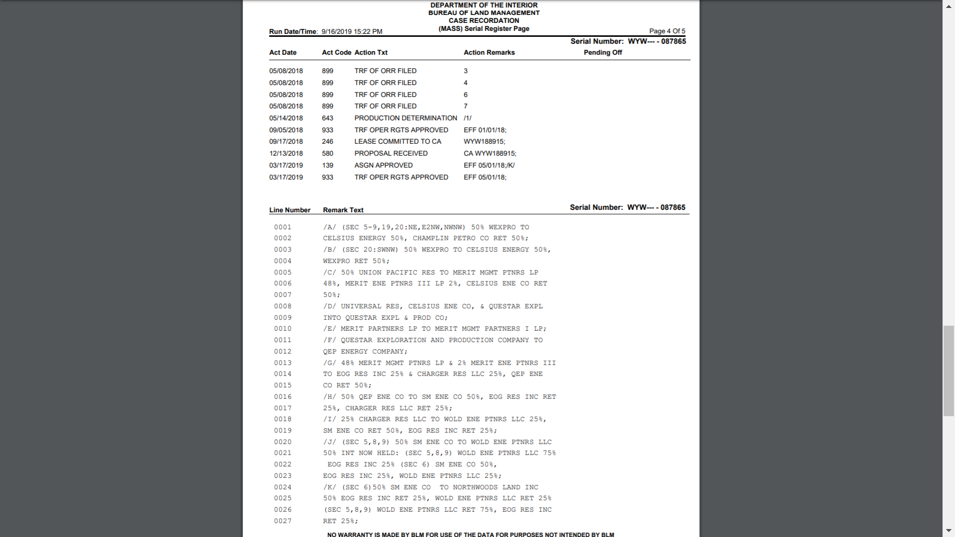

Slide 28
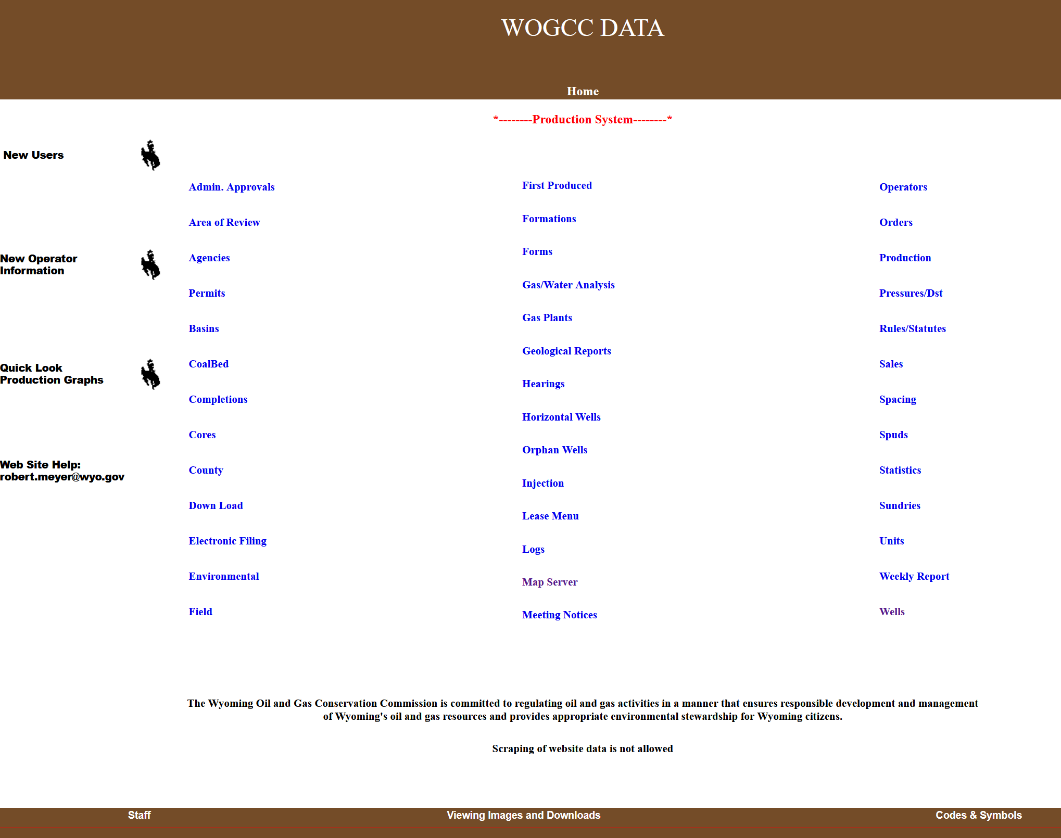
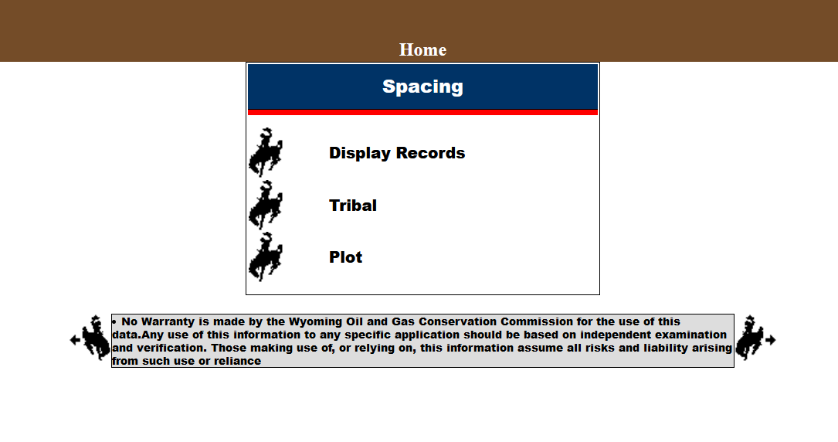
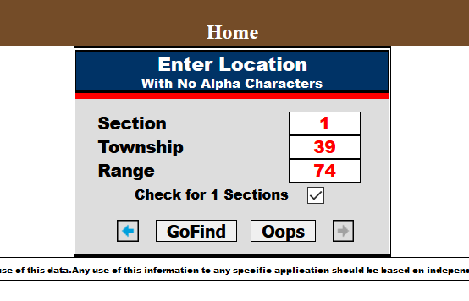
WOGCC
Wyoming Oil and Gas Conservation Commission
  http://wogcc.wyo.gov/
DATA
  http://pipeline.wyo.gov/legacywogcce.cfm
  Spacing ->
  Display Records ->
  Check for 1 Section
Codes & Symbols

Slide 29
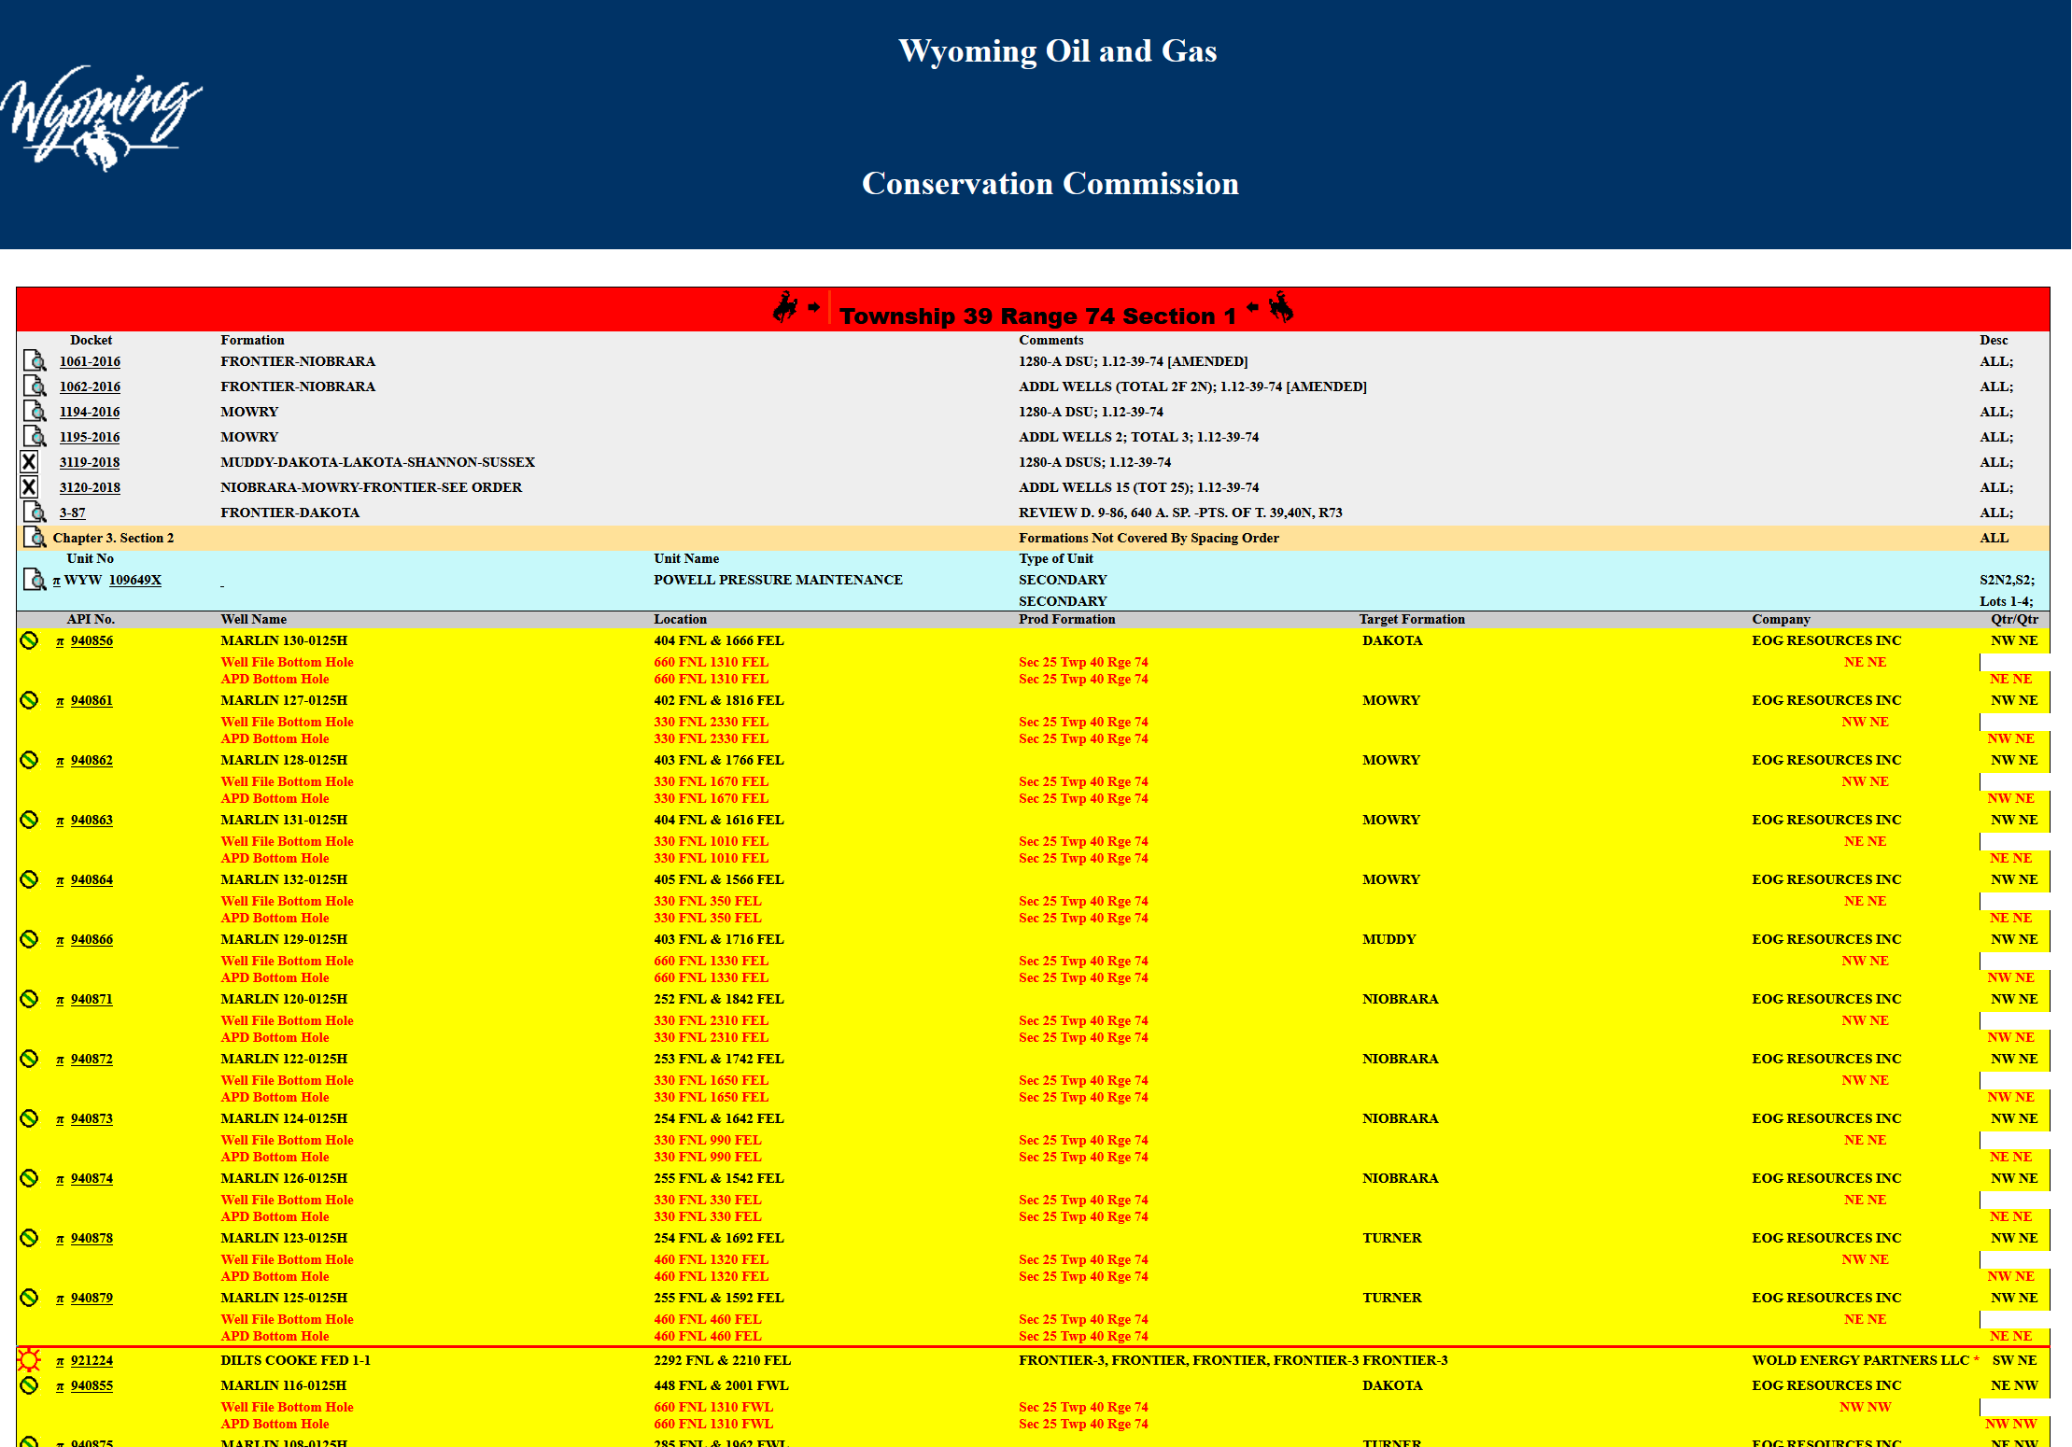
WOGCC

Slide 30
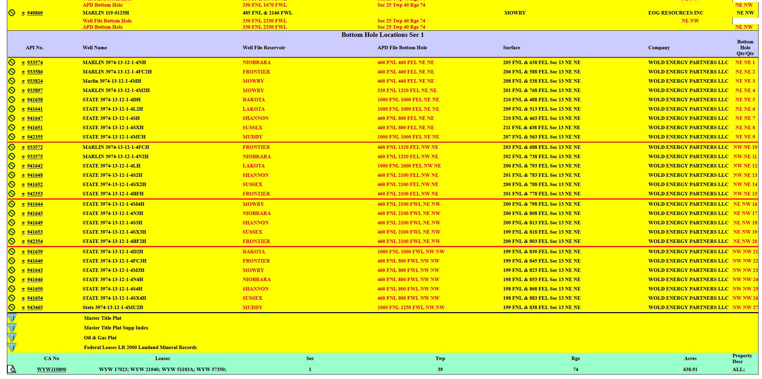
WOGCC

Slide 31

COVID – 19 and Oil and Gas
What was, What is, What will be
  Saudi Arabia, Russia, COVID – 19
  EIA Projections
What to do
  Mitigation
  Preparation
  Options
“Companies go bankrupt, but rocks don’t go bankrupt. When this all shakes out, there will be other people to develop shale,” Daniel Yergin, Legendary oil historian, end of March 2020

Slide 32
Federal Lease Extension Options
Lease Termination
  Expiration
  Cessation of production in the extended term
  Failure to make proper rental payments
Lease Extension
  Production in paying quantities
  Drilling over primary term
  Lease segregation
  Compensatory royalty
  Units and Communitization Agreements
  Suspensions

Slide 33
Lease Reinstatement for failure to pay rentals
Class I Reinstatement
  Rentals paid within 20 days
  “Justified”
  “Reasonable Diligence”
Class II Reinstatement
  Rentals not paid within 20 days
  File petition for reinstatement
  Increased rentals and royalties
43 CFR (§§ 3108.1 - 3108.5)
See next slide for additional COVID-19 relief options

Slide 34
Additional BLM Relief Options
Due to COVID-19
Royalty Reduction
  Regulatory and Process Information for Onshore Oil and Natural Gas Suspensions and Royalty Rate Reduction Applications due to COVID-19 Impacts
  43 CFR § 3103.4-1
  https://www.blm.gov/programs/energy-and-minerals/oil-and-gas/covid-royalty-rate-reduction-guidance
Lease Suspension
  Regulatory and Process Information for Onshore Oil and Natural Gas Suspensions Applications due to COVID-19 Impacts
  Steps for Lessees to Apply for Oil and Gas Suspensions under “force majeure” due to COVID-19
  https://www.blm.gov/programs/energy-and-minerals/oil-and-gas/covid-lease-suspension-guidance

Slide 35
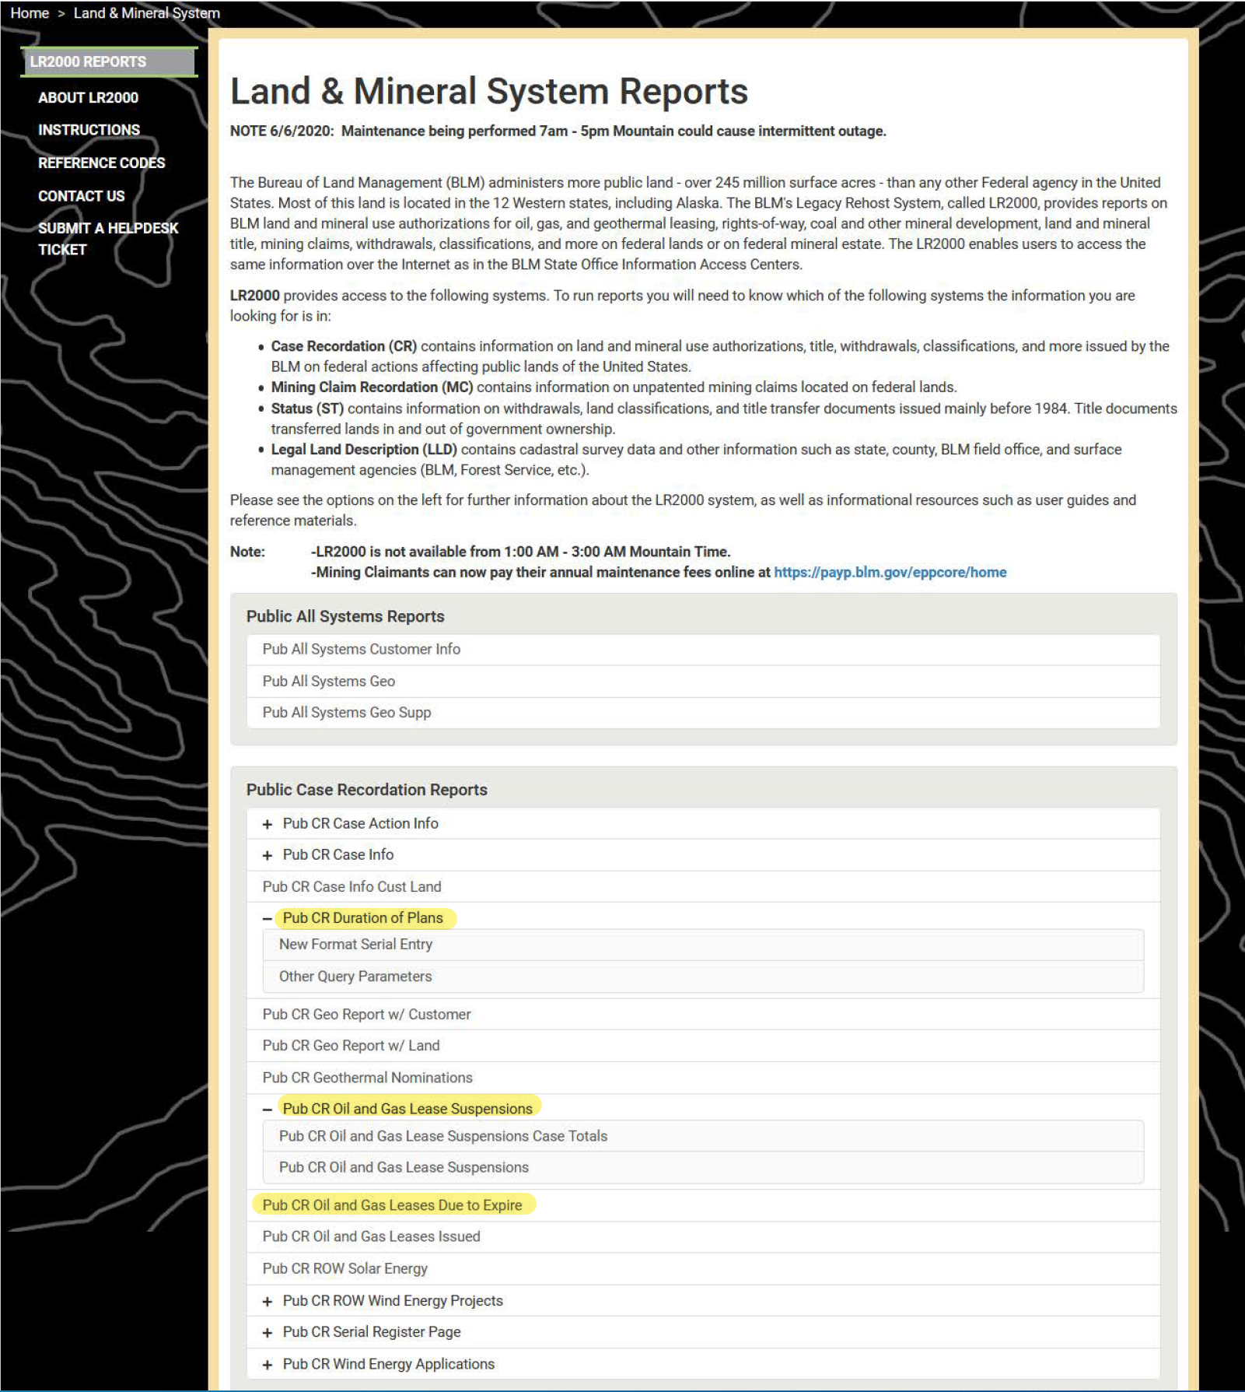
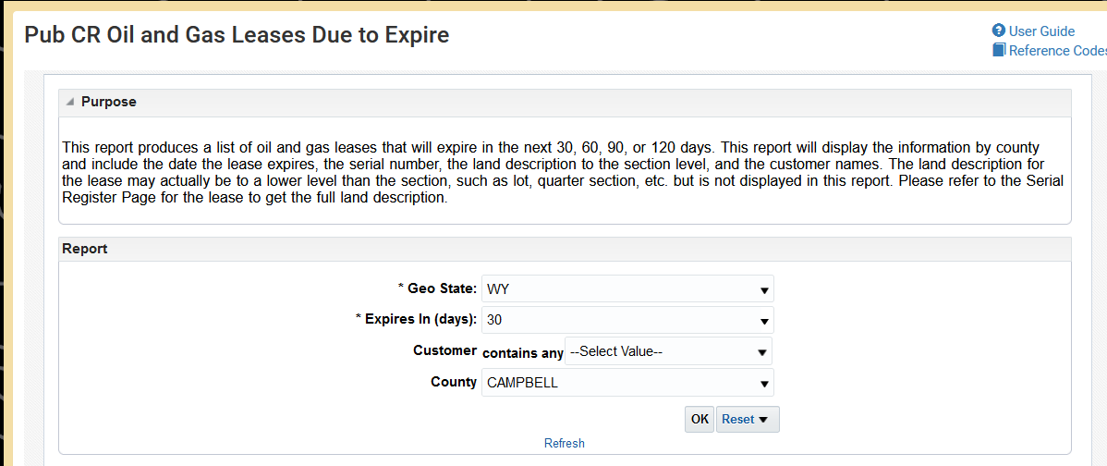
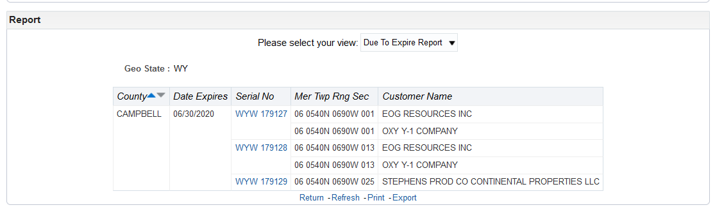
LR2000 Lease Status and new features
Oil and Gas Leases Due to Expire
Oil and Gas Lease Suspensions
Duration of Plans
Wind and Solar

Slide 36



Unemployment & Resources
Wyoming Business Council
  https://www.wyomingbusiness.org/
Wyoming Workforce Services
  https://wyui.wyo.gov
Wyoming At Work Job Search
  WyomingatWork.com
Wyoming Department of Health
  https://health.wyo.gov/behavioralhealth/mhsa/

Slide 37
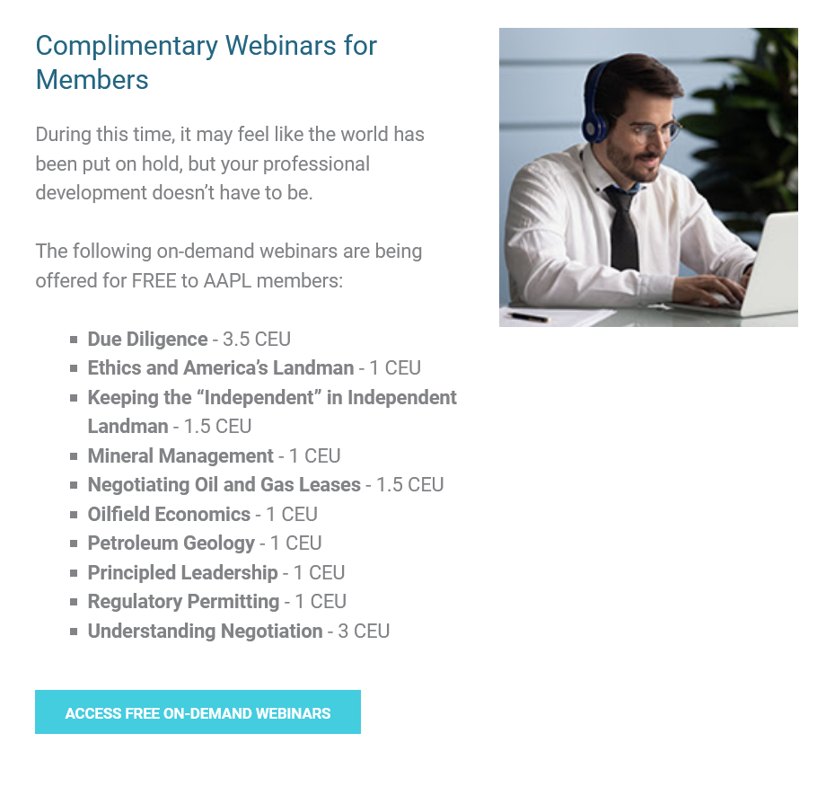

CEUs and Certifications

Slide 38
Practical Links & Resources:
General Land Office Records, patents and plats -- https://glorecords.blm.gov/default.aspx
GLO records reference codes and key for Wyoming plats -- https://glorecords.blm.gov/reference/downloads/WY_Explanatory_Township.pdf
Link to LR2000 -- www.blm.gov/lr2000
CR Action Codes for LR2000 (for use in LR2000 Serial Register Pages) -- https://reports.blm.gov/document/lr2000/118/Action-Codes-by-Code
Wyoming Oil & Gas Conservation Commission including Oil and Gas rules, regulations, spacing, communitizations, units, individual well production, permits, hearing and other information -- http://wogcc.wyo.gov
BLM Name Change Index - BLM Corporate Name Change and Merger Index, dated March 12, 2020-- https://eplanning.blm.gov/public_projects/nepa/75541/102244/250019733/Master_NC_Index_03-12-2020.pdf

Slide 39
Questions?
Thank you!
Tatyana Bannan
TatyanaBannan@gmail.com
Bannan@Hampton-Milligan.com
(307)421-6655

